Slide 1
Introduction to Computing
for the Social Sciences
Session 12+13 - Parallel Programming and Social Science Applications
David Garcia
Winter Semester 2024-25
29.01.2025

Slide 2
Course Outline
Session 1: Introduction
Session 2: Information Coding
Session 3: Data Structures
Session 4: Programming
Session 5: Algorithms
Session 6: Recursion
Session 7: Sorting Algorithms
Session 8: Time Complexity
Session 9: Formal Languages and Automata
Session 10: Turing Machines and Complexity Classes
Session 11: Databases
Session 12: Parallel Programming
Session 13: Social Science Applications
Session 14: Exam Review
Review form for questions/requests up to 24 hours before: https://forms.gle/sJTNjHW6KLsaScHz7
Last time for face-to-face questions, after that only on Discord

Slide 3
Overview Session 12
Parallelization
Hardware Parallelization
Software Parallelization
Limitations of Parallelization

Slide 4
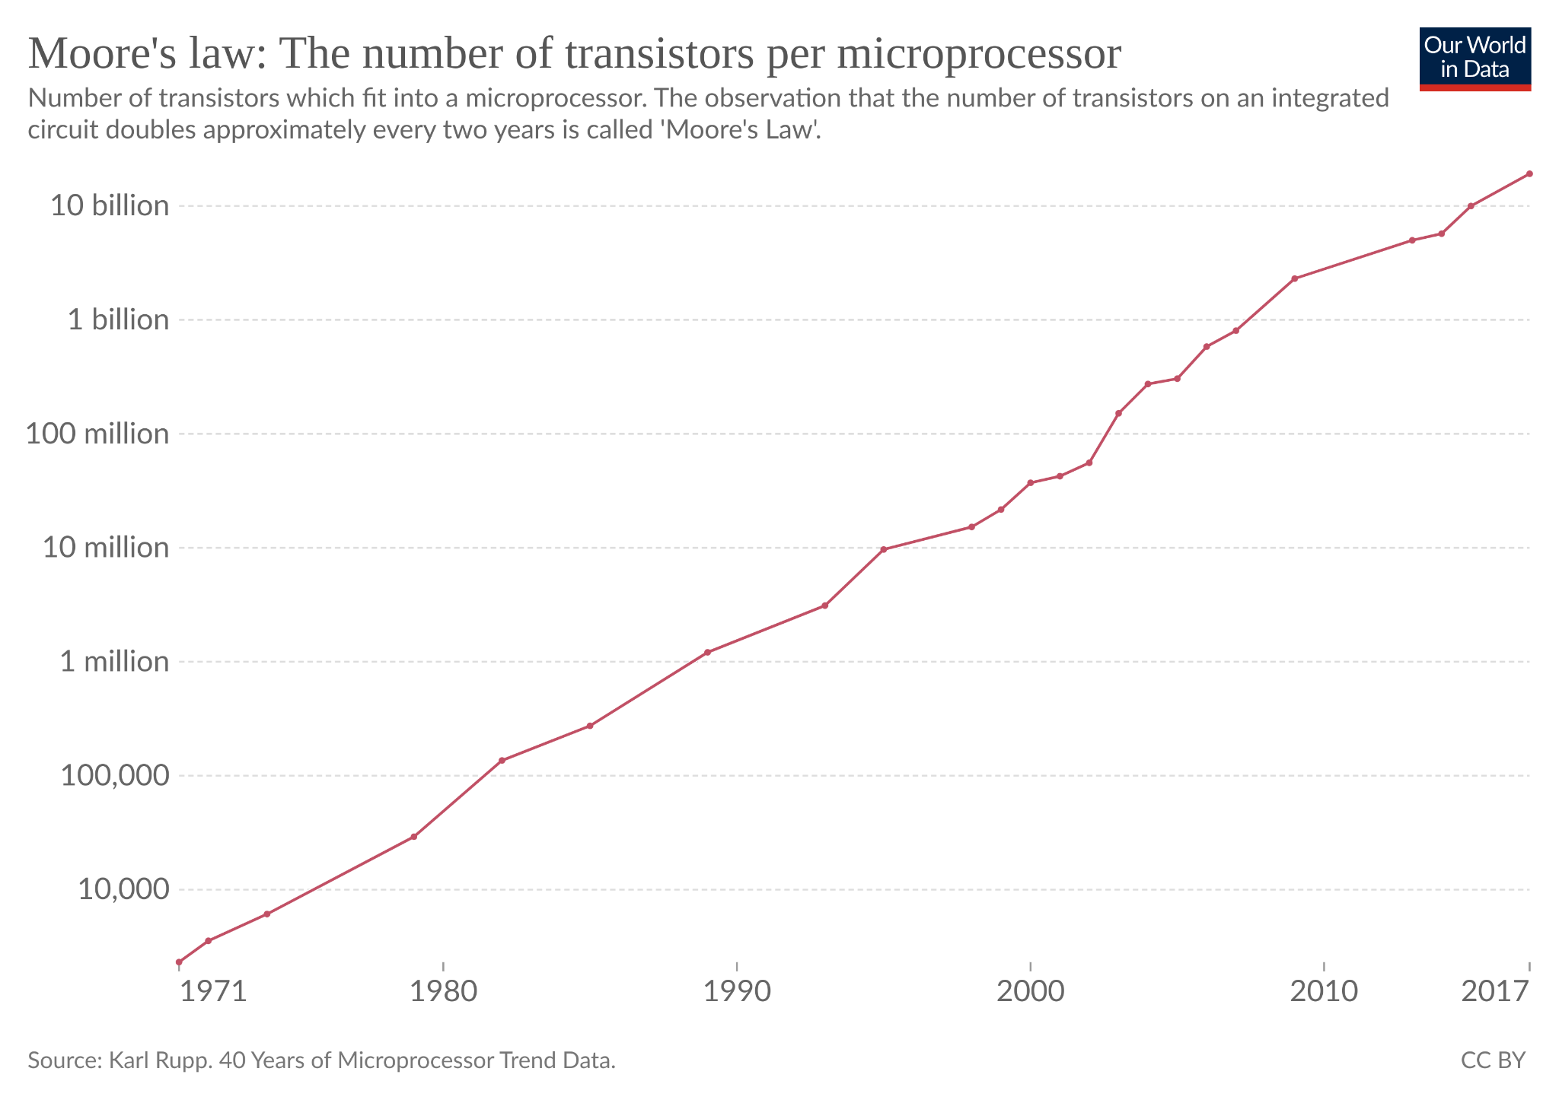
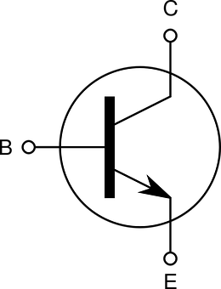
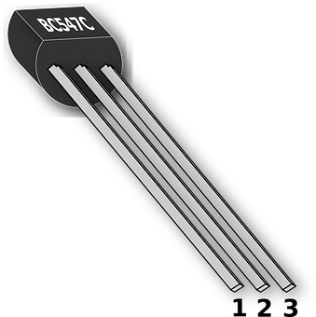
Moore's law

Slide 5
Moore's law and its limits
Moore's law predicts that the number of transistors per microchip doubles every two years - exponential growth in computing power
While increase is still exponential, the rate is slower and doubling takes more than two years
There is a physical limit: a transistor cannot be smaller than an atom
Limit expected to be reached in this decade unless radically different models of computation become feasible
Parallelization is a workaround to this limit: using several processors
To learn more about Moore's law: https://ourworldindata.org/technological-change#advances-in-computational-technology

Slide 6
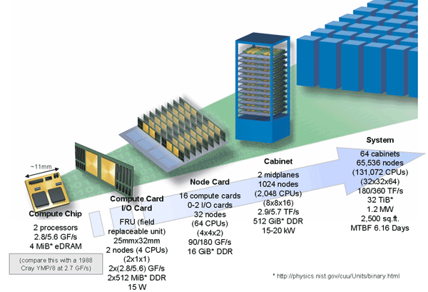
Parallel computer example: IBM Blue Gene
https://en.wikipedia.org/wiki/IBM_Blue_Gene

Slide 7
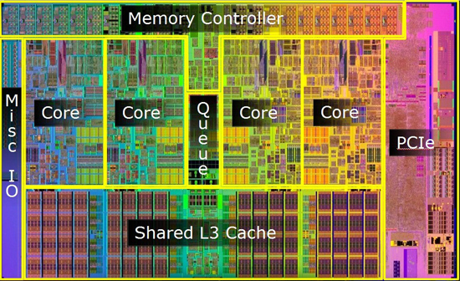
Types of parallelization
Different ways to “multiply” processing:
multiprocessor: more than one CPU
multicore: one CPU with several cores
multithreading: single core executes more than one task concurrently
Process
CODE DATA FILE POINTERS
thread 1
registers stack
thread 2
registers stack
thread 3
registers stack

Slide 8
Single-thread vs Parallel
Single-thread (sequential)
Parallel
CPU 1
task 1
task 2
task 3
CPU 1
task 1
CPU 2
task 2
CPU 3
task 3

Slide 9
Concurrent vs Parallel
Concurrent
Parallel
task 1
task 2
task 3
task 1
task 2
task 3

Slide 10
Concurrent vs Parallel
Concurrency
Concurrency means executing multiple tasks at the same time but not necessarily simultaneously.
Concurrency means that an application is making progress on more than one task at the same time (concurrently). It does not completely finish one task before it begins the next.
Tasks on same CPU, order not completely fixed
Parallelism
Parallelism means that an application splits its tasks up into smaller subtasks which can be processed in parallel
Tasks on different CPUs, tasks are at certain times executed in parallel

Slide 11
Concurrency costs and advantages
CPU 1
task 1
task 2
task 1
task 3
Switching between tasks takes computing time
e.g. loading data or instructions into memory
This is handled by the operating system, using that compute time
Concurrency can save time when using resources that are slower than the CPU. The CPU can change to a process when a slow task starts.
For example:
access to files in the hard drive
access to information over a network
access to data from a peripheral device
user input

Slide 12
Hardware Parallelization
Parallelization
Hardware Parallelization
Software Parallelization
Limitations of Parallelization

Slide 13
Instruction-level parallelism
IF
ID
EX
MEM
WB
CPU architectures have instructions that are divided into microinstructions
Each microinstruction takes a hardware clock cycle.
The example is an architecture with five microinstructions

Slide 14
Instruction-level parallelism
IF
ID
EX
MEM
WB
CPU architectures have instructions that are divided into microinstructions
Each microinstruction takes a hardware clock cycle.
The example is an architecture with five microinstructions
IF: instruction fetch - get next instruction code

Slide 15
Instruction-level parallelism
IF
ID
EX
MEM
WB
CPU architectures have instructions that are divided into microinstructions
Each microinstruction takes a hardware clock cycle.
The example is an architecture with five microinstructions
IF: instruction fetch - get next instruction code
ID: instruction decode - convert code into hardware activation flags

Slide 16
Instruction-level parallelism
IF
ID
EX
MEM
WB
CPU architectures have instructions that are divided into microinstructions
Each microinstruction takes a hardware clock cycle.
The example is an architecture with five microinstructions
IF: instruction fetch - get next instruction code
ID: instruction decode - convert code into hardware activation flags
EX: execute - perform calculation based on registry information

Slide 17
Instruction-level parallelism
IF
ID
EX
MEM
WB
CPU architectures have instructions that are divided into microinstructions
Each microinstruction takes a hardware clock cycle.
The example is an architecture with five microinstructions
IF: instruction fetch - get next instruction code
ID: instruction decode - convert code into hardware activation flags
EX: execute - perform calculation based on registry information
MEM: memory access - write results to main memory if necessary

Slide 18
Instruction-level parallelism
IF
ID
EX
MEM
WB
CPU architectures have instructions that are divided into microinstructions
Each microinstruction takes a hardware clock cycle.
The example is an architecture with five microinstructions
IF: instruction fetch - get next instruction code
ID: instruction decode - convert code into hardware activation flags
EX: execute - perform calculation based on registry information
MEM: memory access - write results to main memory if necessary
WB: register write back - change registers (e.g. next instruction pointer)

Slide 19
Instruction-level parallelism
IF
ID
EX
MEM
WB
CPU architectures have instructions that are divided into microinstructions
Each microinstruction takes a hardware clock cycle.
The example is an architecture with five microinstructions
IF: instruction fetch - get next instruction code
ID: instruction decode - convert code into hardware activation flags
EX: execute - perform calculation based on registry information
MEM: memory access - write results to main memory if necessary
WB: register write back - change registers (e.g. next instruction pointer)
Not all instructions need all five cycles. Details depend on architecture
Different parts of the hardware are used for each microinstruction

Slide 20
Instruction-level parallelism
IF
ID
EX
MEM
WB
i
IF
ID
EX
MEM
WB
time
IF
ID
EX
MEM
WB
A canonical processor without parallelism: takes 5 clock cycles per instruction
IF
ID
EX
MEM
WB
A pipelined processor can simultaneously execute five instructions
It can take up to only one clock cycle per instruction
IF
ID
EX
MEM
WB
i
IF
ID
EX
MEM
WB
IF
ID
EX
MEM
WB
IF
ID
EX
MEM
WB
time

Slide 21
Instruction-level parallelism: caveats
IF
ID
EX
MEM
WB
IF
ID
EX
MEM
WB
i
IF
ID
EX
MEM
WB
IF
ID
EX
MEM
WB
IF
ID
EX
MEM
WB
time
Speculative execution: Future instructions start before we finish one
Control flow usually make the CPU to throw away future instructions
E.g. if statement changes next instruction → need to clean the pipeline
Security risks: speculative execution leaves traces that can be read by other programs
Spectre and meltdown vulnerabilities make it possible to read private data of other programs left in the registers of speculated execution

Slide 22
Multi-core processors: your laptop
Several cores per processor allow executing multiple threads in parallel
Most likely in this course, all student laptops and mobile phones are multi-core and many even multi-processor
https://superuser.com/questions/584900/how-distinguish-between-multicore-and-multiprocessor-systems

Slide 23
Computing clusters
Computing cluster: linking many computers with very high bandwidth connections.
Example: Scientific Compute Cluster (SCC) of Uni Konstanz
Infiniband: 56 Gbit/s, 0.7 s latency
Intel Broadwell HPC compute nodes
28 core per node
up to 1024 GB RAM
large RAID (redundant array of independent disks) memory
The Politics & Public Administration department is an SCC shareholder with 4 compute nodes, i.e. 112 cores
part of the larger SSC infrastructure
if available, can use compute nodes of other shareholders. Resources might be idle when other departments do not need them

Slide 24
Software Parallelization
Parallelization
Hardware Parallelization
Software Parallelization
Limitations of Parallelization

Slide 25
Types of Software Parallelization
Multiple threads or processes in the same computer
E.g. Running mergesort with calls in separate parts of the memory
Issues: Coordinating memory access
Solutions: Inter-process communication (IPC) and Message Passing Interfaces (MPI) - not covered here
Multiple machines connected through a network: distributed computing
E.g. splitting parts of mergesort to different machines and merging results in more central machines
Issues: network communication is the bottleneck for computation
Solutions: distributed paradigms like MapReduce

Slide 26
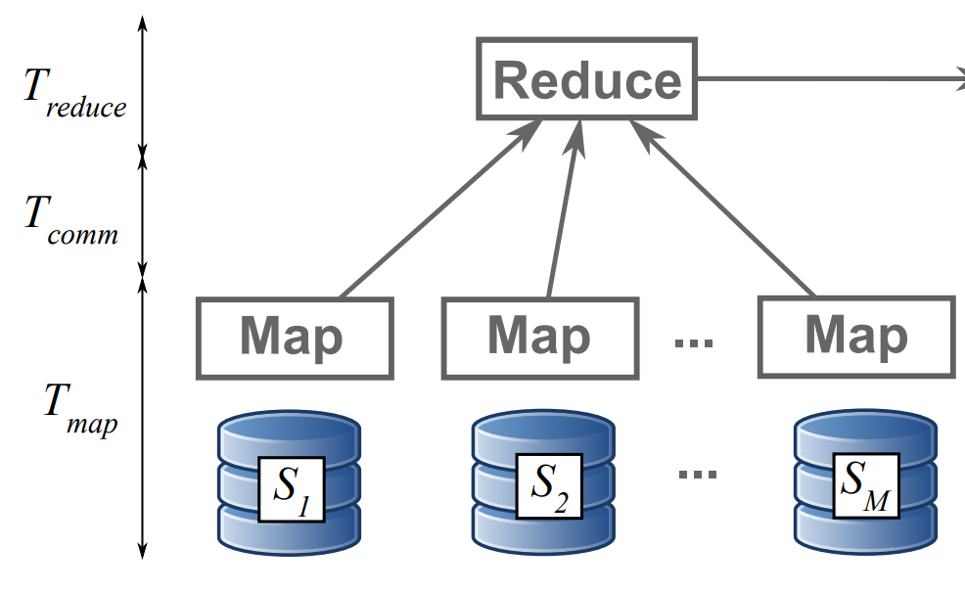
MapReduce

Slide 27


MapReduce
Map phase: compute parts of the solution in partial datasets in each machine
Communication phase: send Map results to the Reducer over the network
Reduce phase: combine Map results into the final solution
Computations can take several Map-Reduce iterations or hierarchies
Apache Hadoop and Spark are some of the most popular software solutions for MapReduce

Slide 28
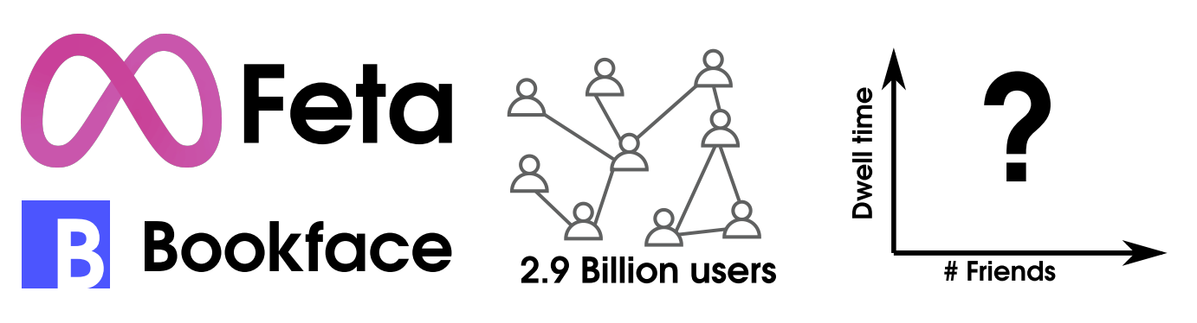
Distributed statistical inference example
Billions of data points distributed in several thousand data servers
Objectives:
Save time by using distributed architecture: bring code to the data
Warning! Communication time matters (vs. plain parallel processing)
Inference should have desirable statistical properties and minimize additional error

Slide 29
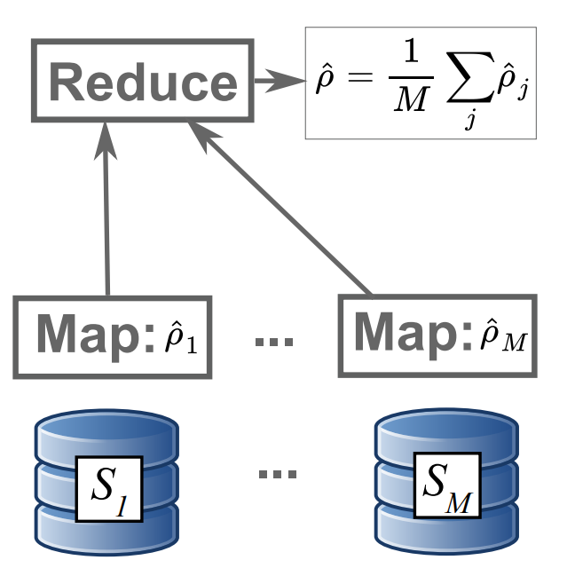
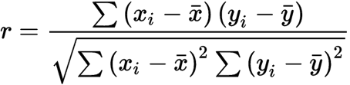
Problems with averaging: Pearson's correlation
Map: compute Pearson's correlation in each local sample
Reduce: aggregate to the final estimator by averaging each Map result

Slide 30
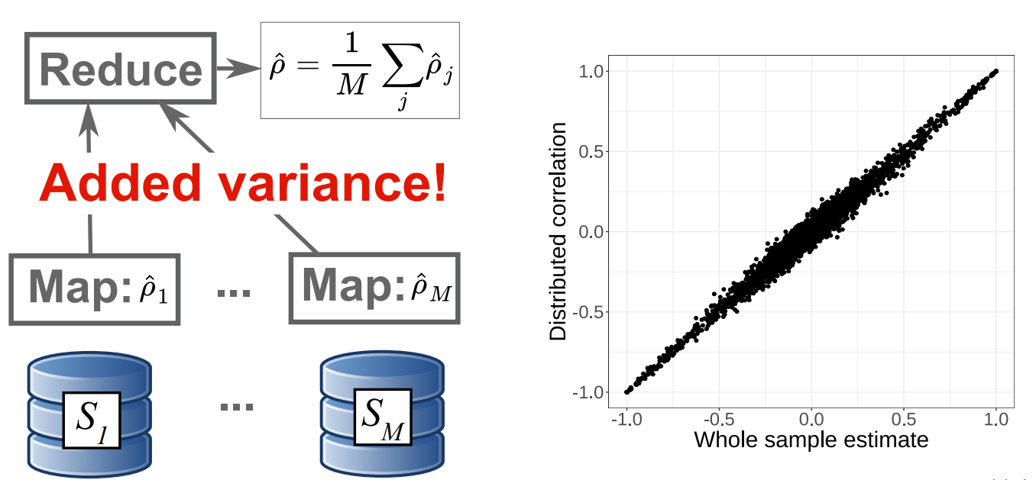
Problems with averaging: Pearson's correlation

Slide 31
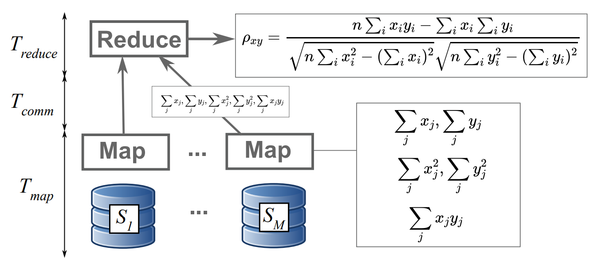
Smarter distributed calculation of correlations

Slide 32
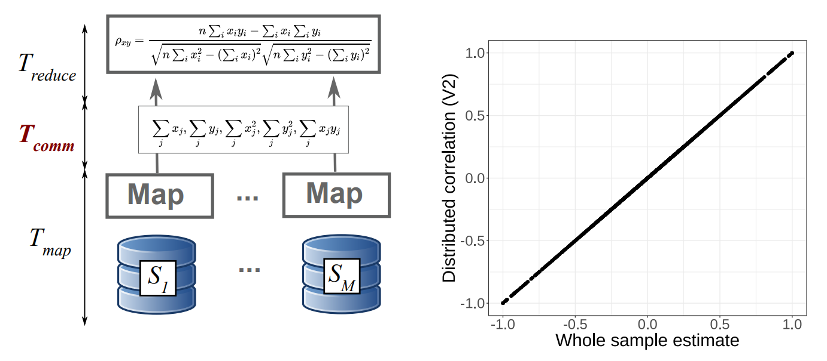
Smarter distributed calculation of correlations

Slide 33
Smarter distributed calculation of correlations
Added communication time tradeoff to avoid added variance in estimate

Slide 34
Limitations
Parallelization
Hardware Parallelization
Software Parallelization
Limitations of Parallelization

Slide 35
Limits to Parallelization
Can you actually achieve an optimal speedup?
Gene Amdahl (1967): there is an upper limit
intuition:
there is always a part of the code that can not be parallelized
with increasing parallelization, this part dominates the overall runtime of the program
maximal speedup depends on two variables:
P: fraction of computation that can be parallelized, e.g. 80%
N: number of processors / threads that can be used in parallel

Slide 36
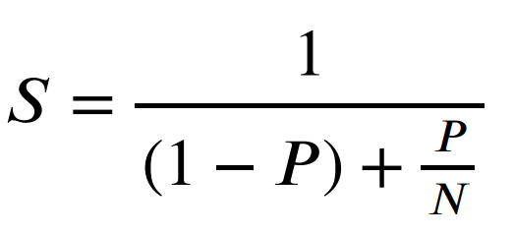
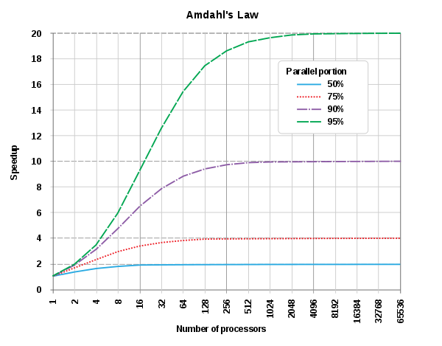
Limits to Parallelization: Amdahl's law
S: Speed up execution of the whole task, e.g. 2x
P: fraction of computation that can be parallelized, e.g. 80%
N: number of processors / threads that can be used in parallel

Slide 37
Summary
Parallelization
Motivation with Moore's law
Example paradigms: multi-core, multi-processor, multi-thread
Parallelization vs concurrency
Hardware Parallelization
Instruction-level parallelization
Multi-core processors, GPUs, and clusters
Software Parallelization
Distributed computing: MapReduce
Limitations: Amdahl's law

Slide 38
Overview
Computational Social Science
Digital Behavioral Data in the Social Sciences
New Methods in the Social Sciences
Computational Analysis of Social Science Theory
Courses Outlook

Slide 39
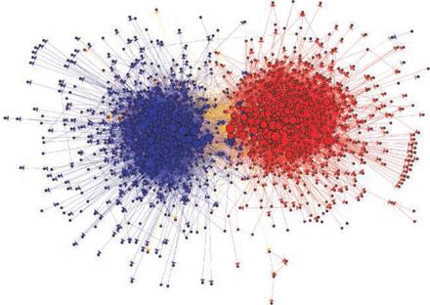
Computational Social Science (CSS)
Computational Social Science
Quantitative testing theories from the social sciences at unprecedented breadth and depth and scale. (Lazer et. al. Science, 2009)
Using new, large-scale data to inform social science theory
Quantitative and empirical, not just theoretical
Not data-driven studies: interdisciplinary research
Computational social science.
D Lazer, A Pentland, L Adamic, S Aral, AL Barabási… Science, 2009

Slide 40
Buzzwords related to Computational Social Science
Social Data Science
Focus on new methods to study human behavior and society rather than on testing or developing social science theory. Almost a synonym of CSS.
Web Science
Study of the Web as a socio-technical system. Empirical studies but also computer science methods development.
Digital Sociology
Sociology of the digital transformation and social phenomena affected by the new use of Information and Communication Technology

Slide 41
Computational in Computational Social Science
It can have three meanings, all related to computation but different:
Digital
Based on large datasets of human behavior, for example produced by the Web and social media
Computerized
The quantitative analysis of data in an automated, tractable, repeatable, and extensible fashion
Generative
Application of data and results to design of agent-based models that explain complex social phenomena and motivate interventions

Slide 42
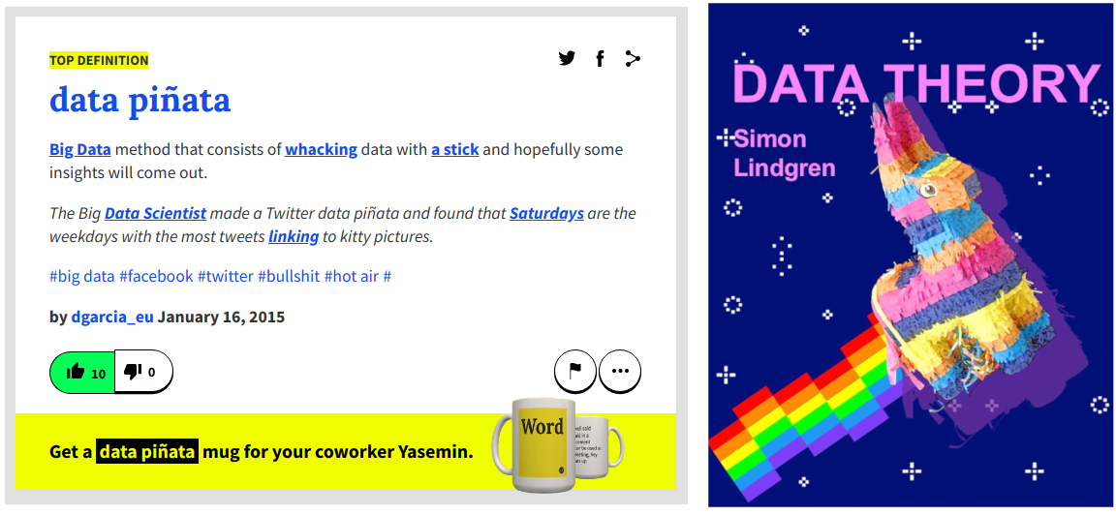
Early data-driven CSS

Slide 43
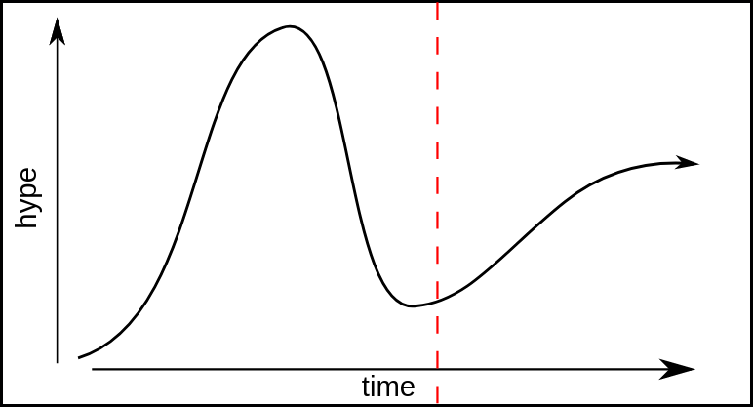
The Gartner Hype Curve of CSS
Bit by Bit: Social Research in the Digital Age. Matthew Salganik, 2017

Slide 44
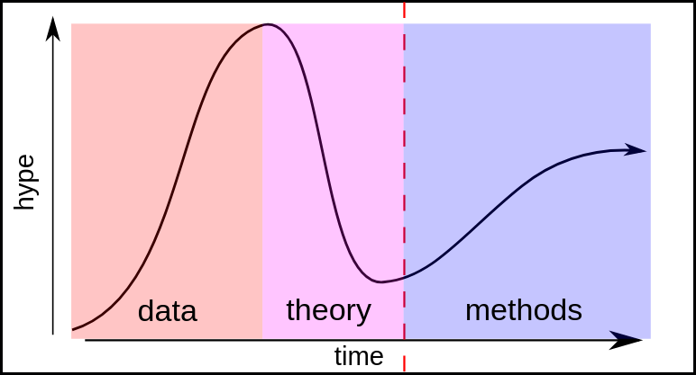
The Three Ages of CSS

Slide 45
Digital Behavioral Data in the Social Sciences
Computational Social Science
Digital Behavioral Data in the Social Sciences
New Methods in the Social Sciences
Computational Analysis of Social Science Theory
Research and Courses Outlook

Slide 46
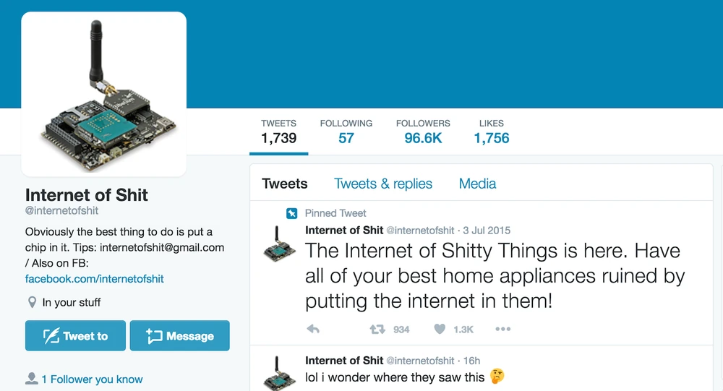
Sensors and connectivity are increasingly pervasive

Slide 47
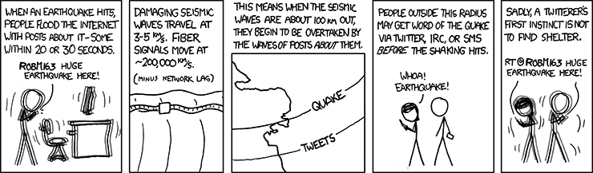
Research example: Earthquakes on Twitter

Slide 48
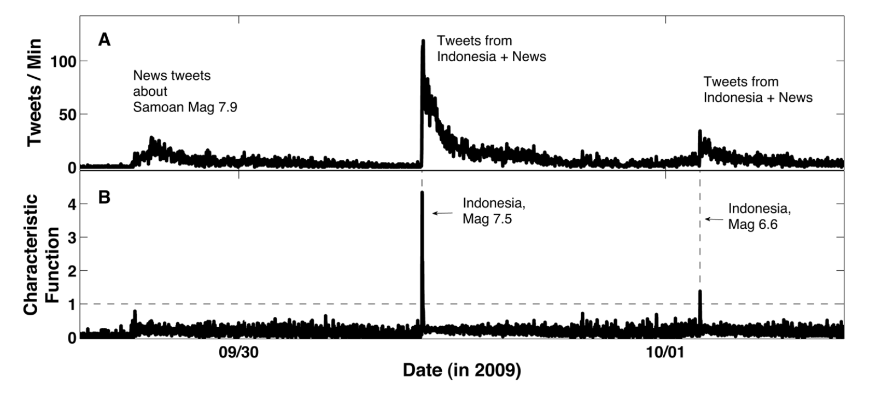
Research example: Earthquakes on Twitter
Earle PS, Bowden DC, Guy M. Twitter earthquake detection: earthquake monitoring in a social world. Ann. Geophys (2012)

Slide 49
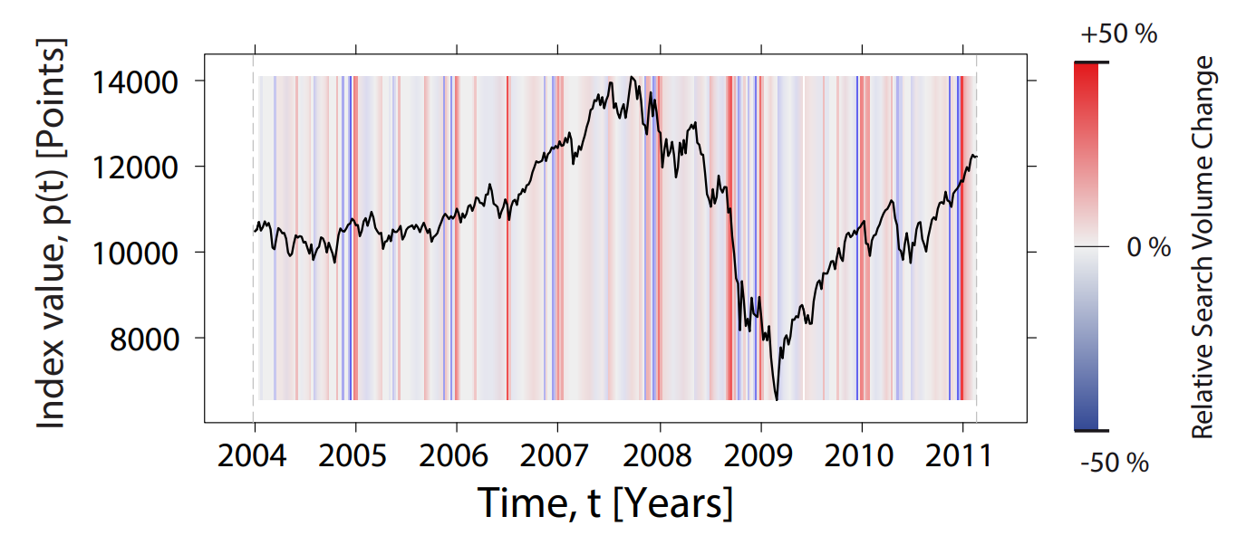
Research example: Trading and Google trends
Quantifying Trading Behavior in Financial Markets Using Google Trends. Tobias Preis, Helen Susannah Moat, H Eugene Stanley. Scientific Reports (2013)

Slide 50
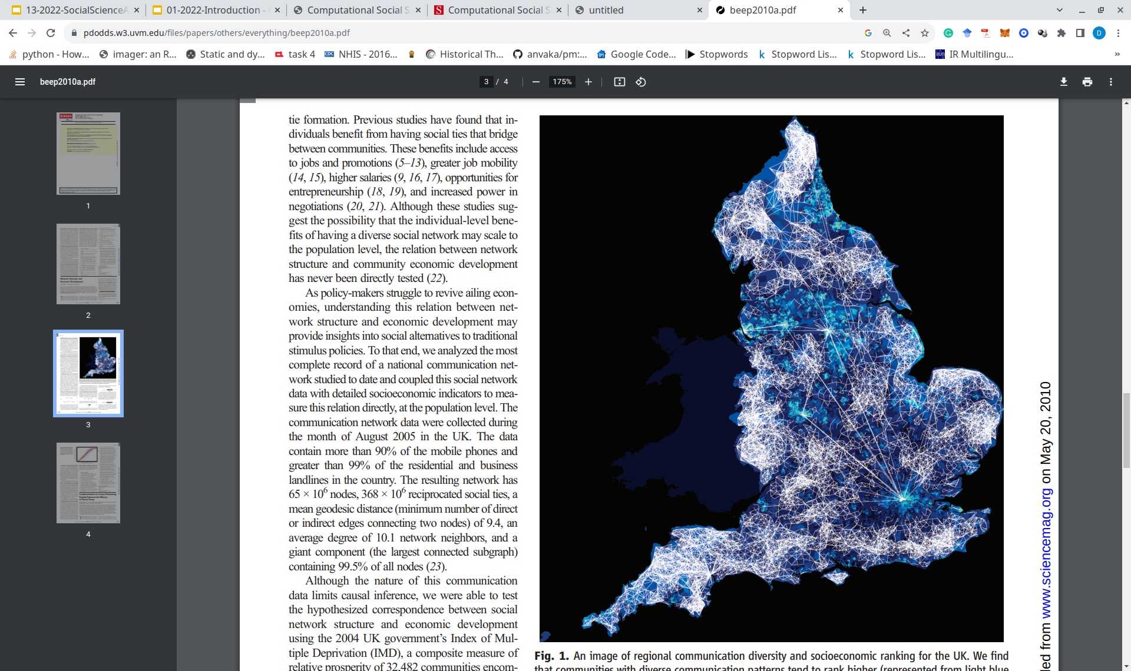
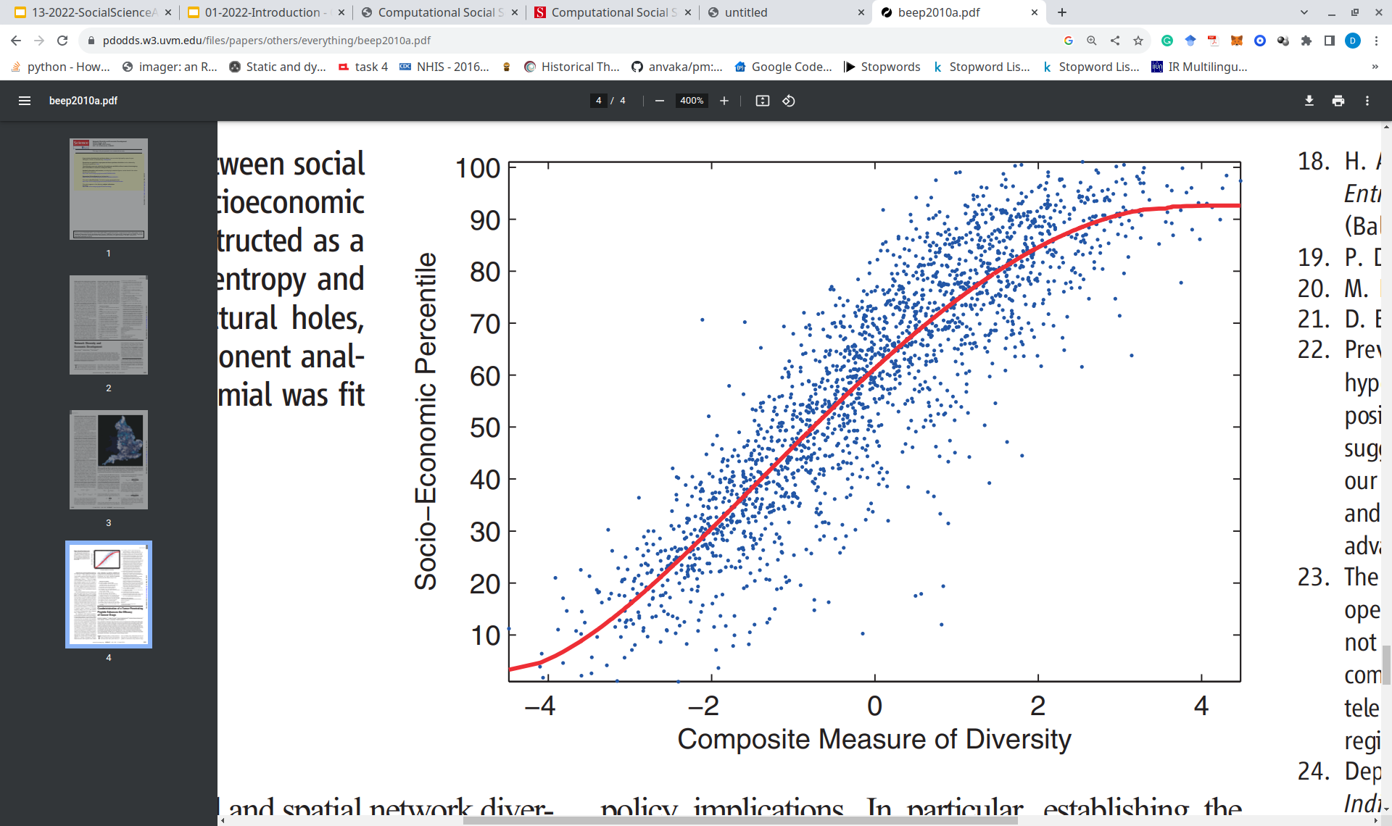
Research example: Mobile Phone Data and Wealth
Network Diversity and Economic Development. N. Eagle, M. Macy, R. Claxton. Science (2010)

Slide 51
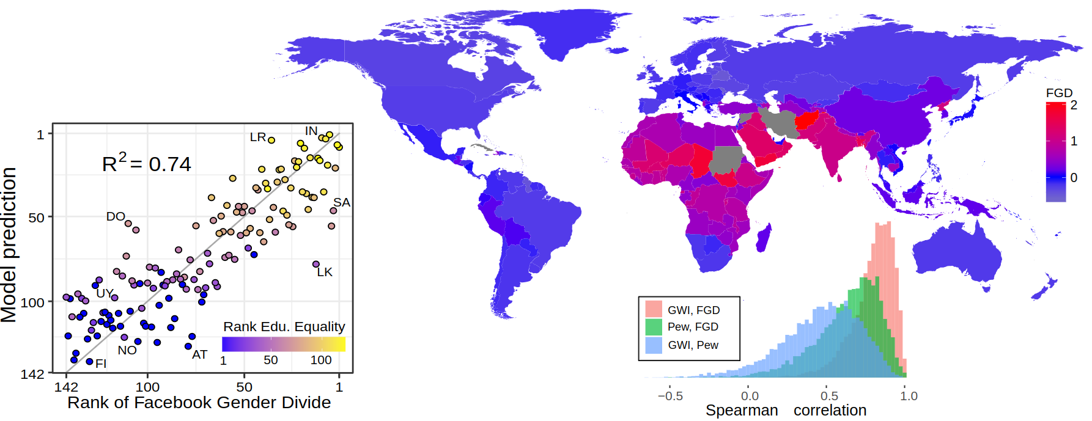
Research example: Gender Inequality with Facebook
Garcia, D., Mitike Kassa, Y., Cuevas, A., Cebrian, M., Moro, E., Rahwan, I., & Cuevas, R. Analyzing gender inequality through large-scale Facebook advertising data. Proceedings of the National Academy of Sciences (2018)

Slide 52
New Methods in the Social Sciences
Computational Social Science
Digital Behavioral Data in the Social Sciences
New Methods in the Social Sciences
Computational Analysis of Social Science Theory
Research and Courses Outlook

Slide 53
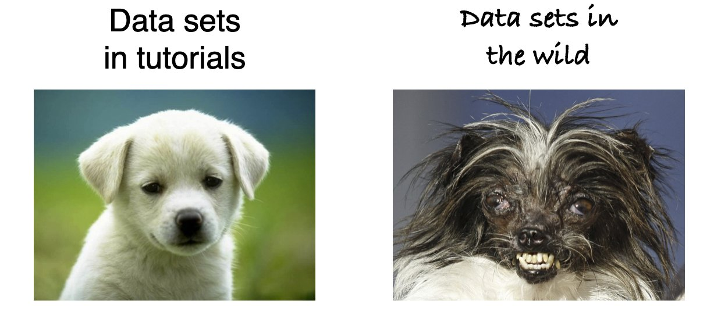
The Challenge of New Unstructured Data
https://twitter.com/mszll/status/1332245497617190913

Slide 54
Heterogenous Data Sources and Methods
Social science data used to have few formats: e.g. experiment outcome annotations or survey responses
Now many more formats and data sources:
data, social networks, locations and timestamps, likes…
Sometimes these formats are even related to each other
Methods have been improving over time:
First generation of methods: Adapting previous social science methods
example: dictionaries in text analysis
Second generation of methods: Using Machine Learning models to generalize measurement from many examples of measurements
example: sentiment analysis
Third generation of methods: Using large models to analyze highly-dimensional data
example: word embeddings - see "document analysis" course

Slide 55
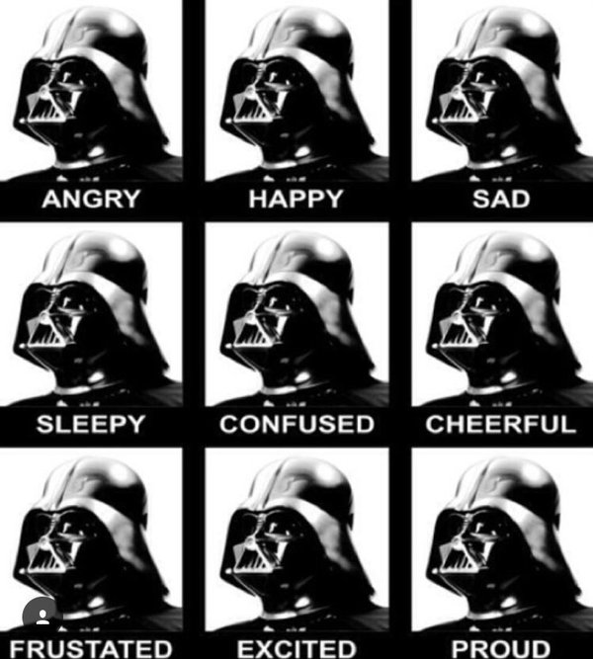
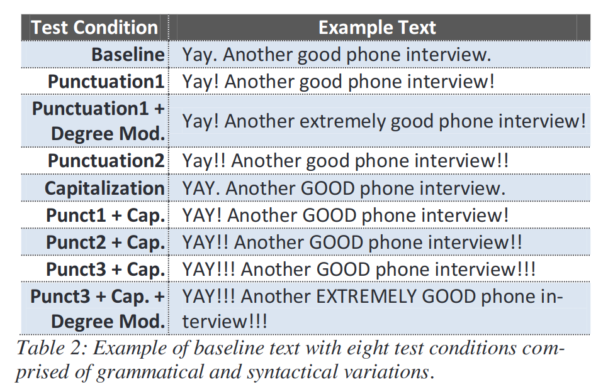
Research Example: VADER sentiment analysis
VADER: A Parsimonious Rule-Based Model for Sentiment Analysis of Social Media Text. C. Hutto, E. Gilbert. ICWSM (2014)

Slide 56
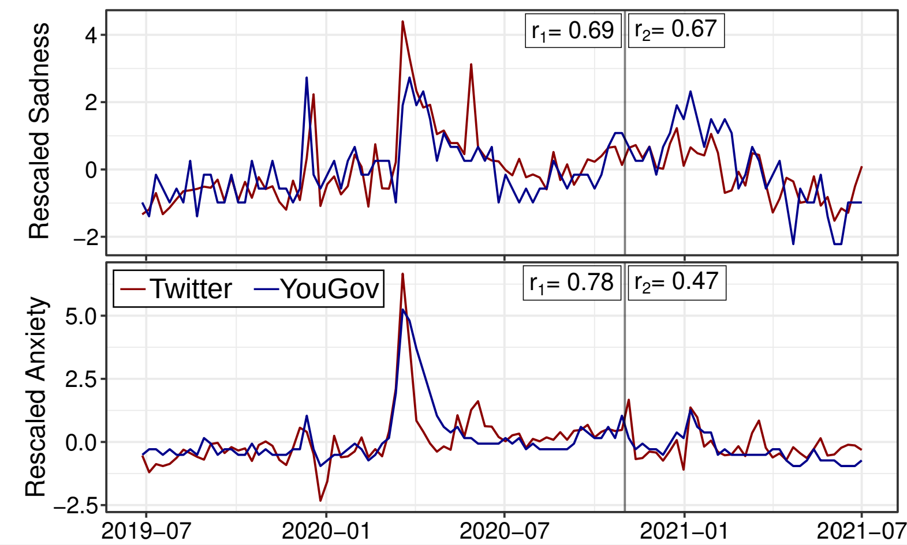
Research Example: Social Media and Emotion Surveys
Social media emotion macroscopes reflect emotional experiences in society at large. D Garcia et al. Arxiv preprint

Slide 57
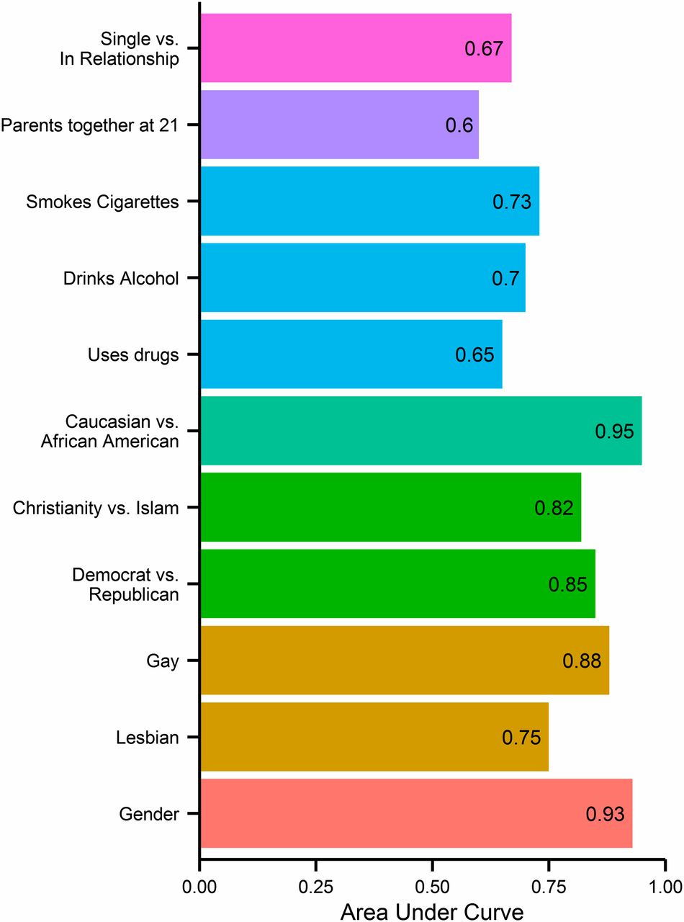
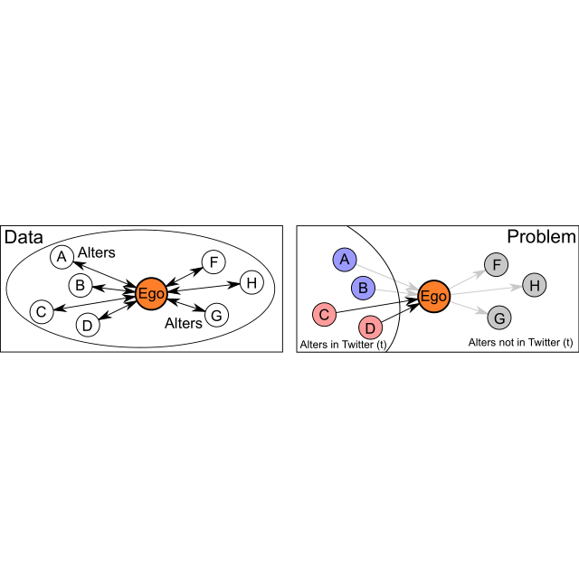
Issues with Methods: New Privacy Risks
Private traits and attributes are predictable from digital records of human behavior. Kosinski et al (2013)
Collective aspects of privacy in the Twitter social network. Garcia et al (2018)

Slide 58
Computational Analysis of Social Science Theory
Computational Social Science
Digital Behavioral Data in the Social Sciences
New Methods in the Social Sciences
Computational Analysis of Social Science Theory
Research and Courses Outlook

Slide 59
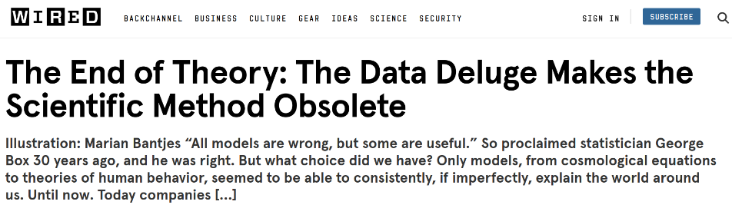
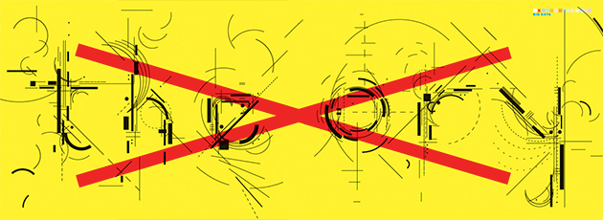
The End of Theory?

Slide 60
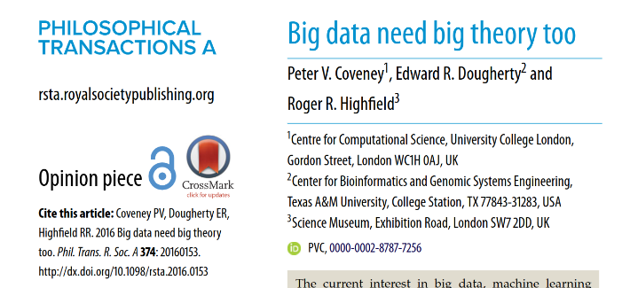
The End of Theory?

Slide 61
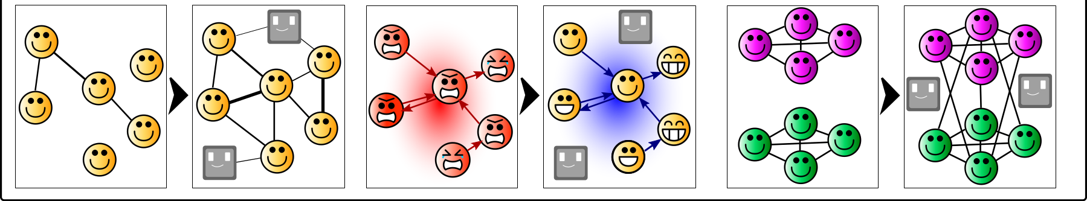
Agent-Based Modelling: Computing and Social Theory
Model humans as agents that symbolize a simplified behavior
Agents have quantifiable variables and properties
All interaction rules are explicitly defined and parametrized
Simulations and mathematical analysis can be applied to derive system properties that might not be easy to conclude from intuition alone
Generates hypotheses and proofs of generative sufficiency
but not empirical evidence

Slide 62
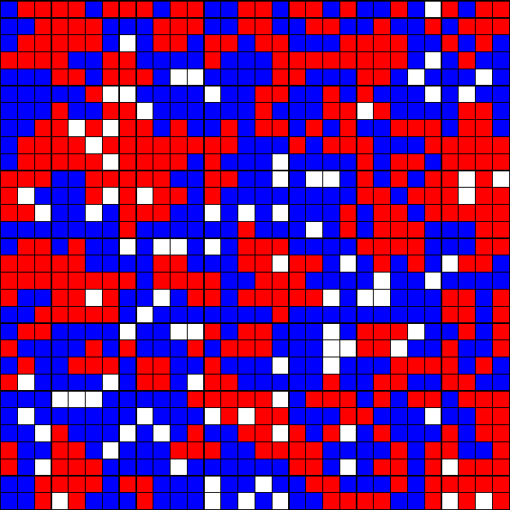
Modelling Segregation: Schelling's Model
Model properties:
Agents of two kinds, similar number
Low but nonzero fraction of empty cells
Cells have a neighborhood of 8 cells around the central cell
Corners and borders have fewer neighbors
Agents are aware of the fraction of similar agents in their neighborhood: f
Agents are satisfied with f ≥ F
If unsatisfied, they jump to the closest satisfying cell
F is a parameter that measures intolerance
Example: simulation with F=0.2

Slide 63
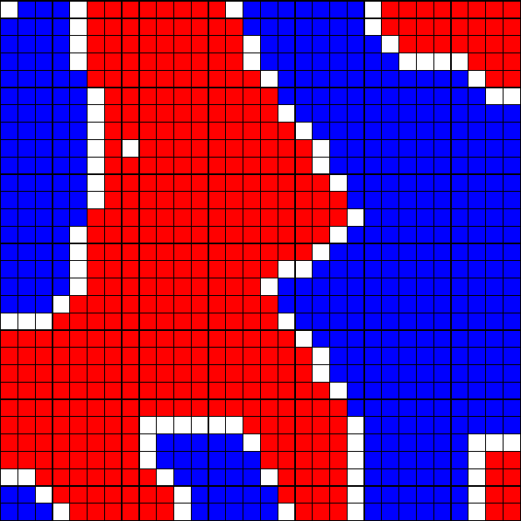
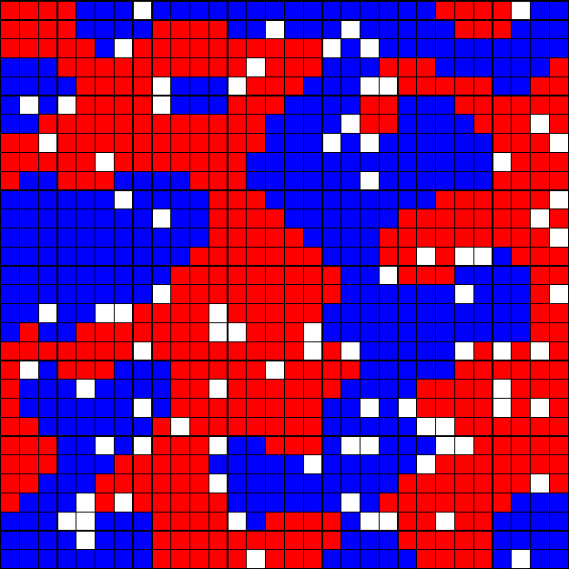
Segregation Under Tolerance in Schelling's Model
Example with F=0.6. Strong segregation
Example with F=0.4. Also segregated!
Dynamic Models of Segregation. Thomas Schelling. Journal of Mathematical Sociology (1971)

Slide 64
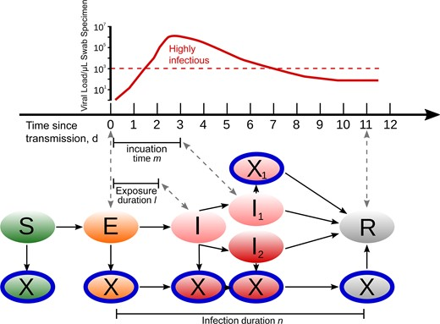
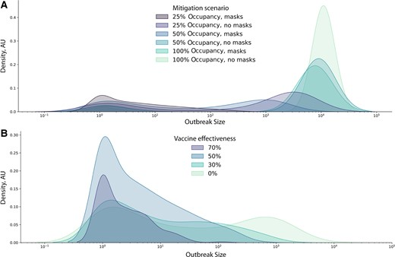
Simulating Effects of Anti-COVID Policies
Assessment of the Effectiveness of Omicron Transmission Mitigation Strategies for European Universities Using an Agent-Based Network Model. J. Lasser, T. Hell, D. Garcia. Clinical Infectious Diseases (2022)

Slide 65
Courses Outlook
Computational Social Science
Digital Behavioral Data in the Social Sciences
New Methods in the Social Sciences
Computational Analysis of Social Science Theory
Courses Outlook

Slide 66

Social Media Data Analysis
9 ECTS (2+2 SWS)
Next SS taught by David Garcia
Course contents:
Analysis of search data to measure information seeking
Popularity and social impact in social media
Application and evaluation of sentiment analysis techniques for social media text
Methods and applications of social network analysis in online media
Practical assignments where you get and analyze your own data

Slide 67
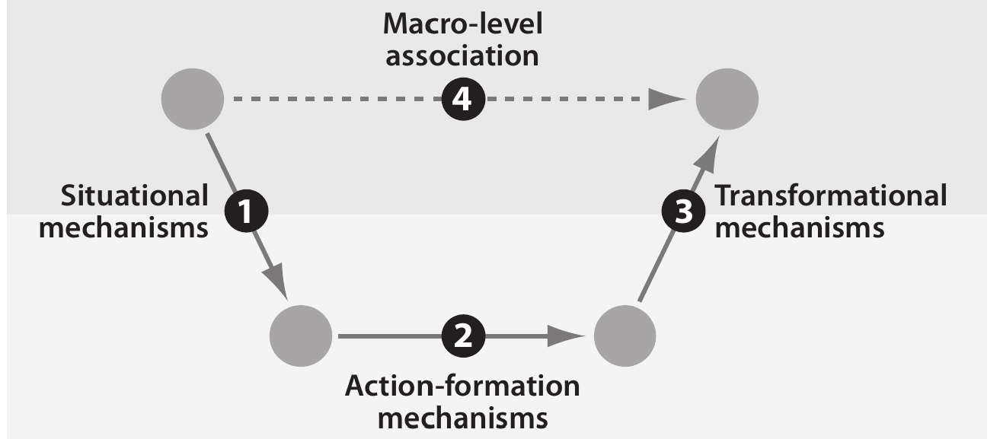
Computational Modelling of Social Systems
Seminar with exercises: 6 ECTS (2 + 2 SWS)
Next Summer Semester taught by David Garcia
Lectures and exercises on Agent-Based Modelling and Complexity Science
Topics:
Modelling segregation: Schelling's model
Modelling cultures: Axelrod's model
Spreading of behavior
Opinion dynamics
Network growth models
Social resilience
Python exercises with Mesa

Slide 68
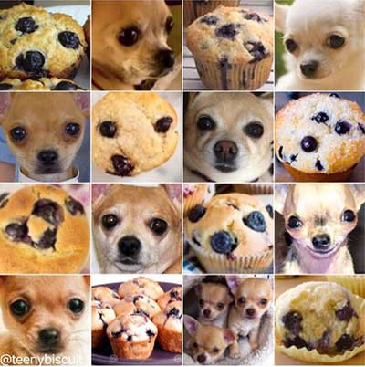
Deep Learning for the Social Sciences
9 ECTS (2+2 SWS)
Taught next SS by Giordano De Marzo
Machine Learning concepts
Multilayer perceptrons and their limitations
Convolutional Neural Networks
RNN, LSTM, RL
Applications to time series, graphs, generative modelling and NLP
Exercises in PyTorch

Slide 69

Path to Master Thesis
Recommendation: take Colloquium in Social Data Science the semester before master thesis
Preparation by joining group research updates (Tuesdays 13:30-15:00)
Students prepare their thesis plan during the semester and present it for input at the end
Manual registration by me, contact before to discuss coursework and potential topics
Second recommendation: take my group’s courses and read our papers

Slide 70
Summary
Computational Social Science
Using new sources of data and computational methods in the social sciences: the three meanings of the word computational
Digital Behavioral Data in the Social Sciences
Social media, search mobile phones… Risks: representation problems
New Methods in the Social Sciences
Text analysis as an example. Risks: privacy
Computational Analysis of Social Science Theory
Agent-Based Modelling to analyze models of social systems
Research and Courses Outlook
Join me next semester if you want to study social media data!
Form for questions/requests up to 24 hours before next session: https://forms.gle/sJTNjHW6KLsaScHz7

